Slide 1

Daniel Kurnath
Network Engineer
4. Networking & Security Fundamentals Chapter 1 – OSI Model

Slide 2
Objectives
Identify and describe the functions of each of the seven layers of the OSI reference model
Identify the reasons why the networking industry uses a layered model
Define and explain the conversion steps of data encapsulation
Define and describe the function of a MAC address
Describe connection-oriented network service and connectionless network service, and identify the key differences between them
Notes:
<number>

Slide 3
Introduction to Networking
Computer network, or simply network
Refers to the connection of two or more computers by some type of medium
You can connect computer using the following:
Public telephone system
Wire cable
Fiber-optic cable
Infrared equipment
Radio equipment
Notes:
<number>

Slide 4
Origin of Networking
Industry experts find it difficult to date the precise origin of networking
Because many devices have been networked throughout history
Mainframe computers were sometimes connected to each other by cables
Today, systems that are part of a network do not have to be identical
A modern network can include a wide variety of computers, peripheral components, and even other networks
Notes:
<number>

Slide 5
Why Do We Use Networks?
This question can be answered in one word: convenience
People expect interoperability from electronic devices
Computer networks allow:
For the transfer of files, data, and even shared applications without copying anything to floppy disk
Computers to share items such as printers, scanners, fax machines, processors, disk drives, and other resources
Networked computers can share data and peripherals
Notes:
<number>

Slide 6
Networking Terminology
Media
Refers to the wire cabling that form the connections in most networks
Some networks use wireless transmission media, such as infrared or radio signals
Client/server networks
Servers host the resources for the clients to use and provide security
A client is the computer that requests resources from the server
Notes:
<number>

Slide 7
Networking Terminology (continued)
Client/server networks (continued)
Types of servers include:
Print server
File server
Database server
Remote access server (RAS)
Web server
Peer-to-peer network
When every computer on a network acts as both a client and a server
Also known as “workgroups”
Notes:
<number>

Slide 8
Networking Terminology (continued)
LAN, WAN, MAN, SAN
Local area network (LAN) is contained within a company or department and located in a single geographic area
Wide area network (WAN) spans multiple geographic areas and is usually connected by common telecommunication carriers
Metropolitan area network (MAN) refers to the intermediate stage between a LAN and a WAN
Notes:
<number>

Slide 9
Networking Terminology (continued)
LAN, WAN, MAN, SAN (continued)
Storage area network (SAN) refers to a series of storage devices that are networked together to provide very fast data storage for a network or subnetwork
Network Operating System (NOS)
Allows communication, security, and distribution of data, files, and applications over a network
Network Interface Card (NIC)
A device that allows a computer or other device to connect to a network through the media
Notes:
<number>

Slide 10
Networking Terminology (continued)
Networking hardware
Describes all the physical components of a network, such as the NIC, cable, hub, switch, router, and any related connectors or devices
Networking software
The programs used to run a network
Virtual private networks
Network that uses a public communications infrastructure (like the Internet) to facilitate private communication between a company LAN and remote employees
Notes:
<number>

Slide 11
Networking Terminology (continued)
Virtual private networks (continued)
Extranet is the part of the company’s network that allows access to nonemployees
Intranet is the part of the company’s network that allows access to employees
Notes:
<number>

Slide 12
Understanding the OSI Model
Open Systems Interconnection (OSI) model
Presented in 1984 by the International Organization for Standardization (ISO)
Based on examination of existing protocols, ISO recommended a seven-layer network model
Allows vendors to implement networks that permit communication among the wide variety of network implementations
The OSI model is not an absolute standard for computer networks
Used as a reference model
Notes:
<number>

Slide 13
Reasons for Layering
Advantages
Simplifies the networking model
Enables programmers to specialize in a particular level or layer
Provides design modularity
Encourages interoperability
Allows networking vendors to produce standardized interfaces
<number>
Notes:
<number>

Slide 14
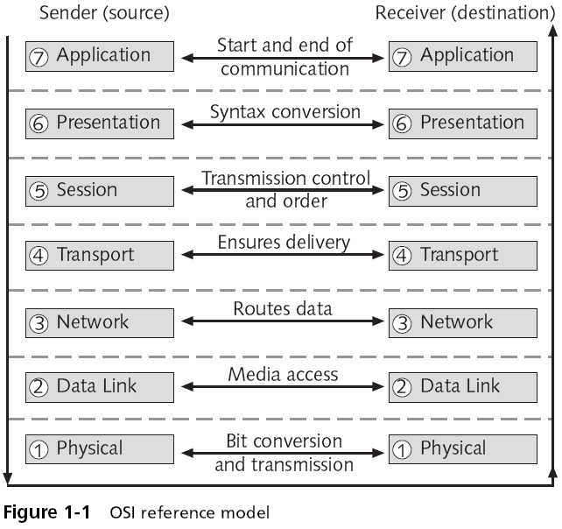
The Layers of the OSI Model
<number>
Notes:
<number>

Slide 15
Reasons for Layering (continued)
Protocol
Defined method for communicating between systems
Computers must use a common protocol to communicate properly
Examples: TCP/IP and IPX/SPX
Notes:
<number>

Slide 16
Peer OSI Communication
Peer communication
Each layer will only talk to its peer on the opposite side of the communications process
Each layer is unaware of the activities of all other layers of the model
Allows error checking to occur on two separate layers simultaneously
Each layer does provide services to the layer above it and receives services from the layer below it
Layers do not acknowledge these services in any way
Notes:
<number>

Slide 17
Layer Functions
The OSI model was developed as an industry standard
For companies to use when developing network hardware and software to ensure complete compatibility
Each layer in the OSI model performs a specific function in the transmission process
Most modern networks do not implement the OSI model exactly as it is defined
Notes:
<number>

Slide 18
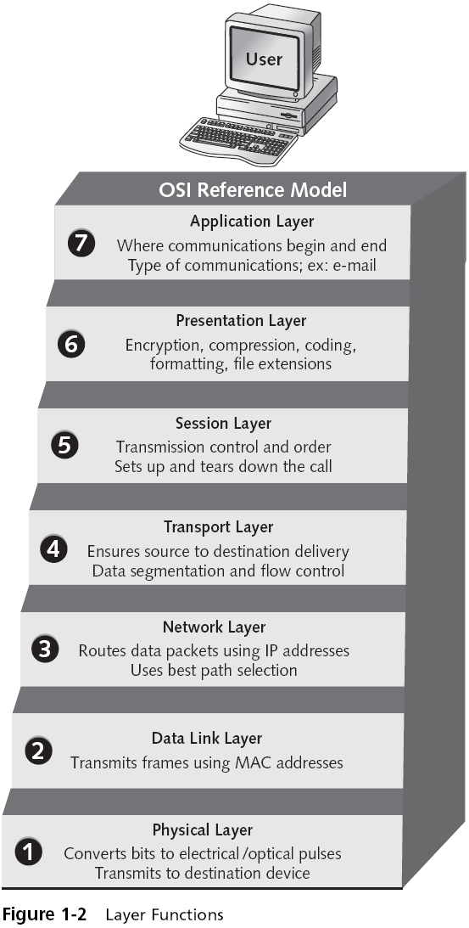
Layer Functions (continued)
Notes:
<number>

Slide 19
Layer Functions (continued)
Physical (Layer 1) responsibilities
Defines the physical characteristics of the network hardware, including cable and connectors
Represents binary digits as voltages (encoding)
Transmits signals on the wire
Notes:
<number>

Slide 20
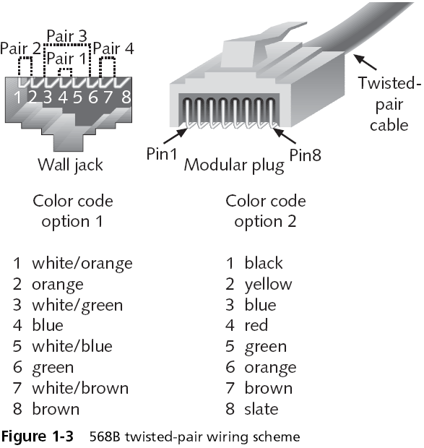
Layer Functions (continued)
Notes:
<number>

Slide 21
Layer Functions (continued)
Data Link (Layer 2) responsibilities
NIC software functions, including the identification of the source and destination nodes via their physical addresses (Media Access Control addresses)
Definition of how data is packaged for transport in smaller units known as frames
Error notification
The Data Link sublayers:
Logical Link Control (LLC) layer
Media Access Control (MAC) layer
Notes:
<number>

Slide 22
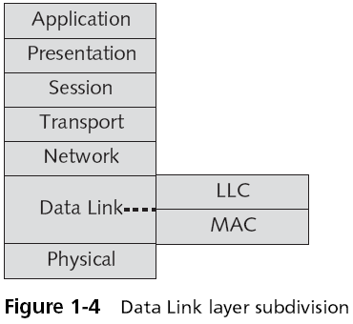
Layer Functions (continued)
Notes:
<number>

Slide 23
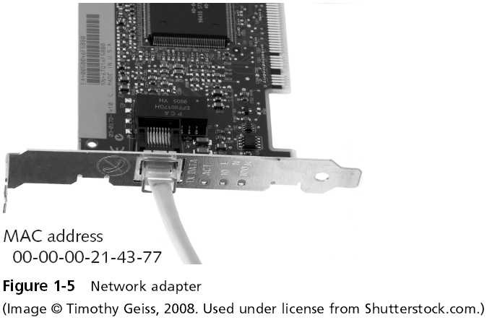
Layer Functions (continued)
Notes:
<number>

Slide 24
Layer Functions (continued)
Network (Layer 3) functions
Software/logical addressing for data packets, such as IP, IPX, and AppleTalk
Data routing and connectivity
Best path selection
Protocols at the Network layer allow computers to route packets to remote networks using a logical address
Notes:
<number>

Slide 25
Layer Functions (continued)
Transport (Layer 4) responsibilities
End-to-end, error-free transmission and delivery between the ultimate sender and ultimate receiver
Flow control
Data segmentation into maximum transmission unit (MTU) size
Messaging service for the Session layer
Protocols that reside at the Transport layer can be connection-oriented or connectionless
Data sent by a connectionless transport is called a datagram
Notes:
<number>

Slide 26
Layer Functions (continued)
Session (Layer 5) services
Control for data exchange (full or half duplex)
Clocking or timing
Failure recovery
Initial link setup and link termination when communications complete
The Session layer allows the transfer of a large set of data across the network
Examples of Session layer protocols include NetBIOS, SQL, RPC, and X-Windows
Notes:
<number>

Slide 27
Layer Functions (continued)
Presentation (Layer 6) responsibilities
Data translation
Data formatting
Data syntax restructuring
Data encryption
Data compression
This layer also provides encryption services when data encryption is used in network communications
Notes:
<number>

Slide 28
Layer Functions (continued)
Application (Layer 7) responsibilities
Initiating the request for network services
Providing network services to applications such as e-mail and Web browsers
This layer is concerned with user interaction with the computer and the network
Contains many protocols and utilities, such as telnet, FTP, HTTP, DNS, SMTP, and SNMP
Notes:
<number>

Slide 29
Layer Functions (continued)
Data encapsulation
Data is sent from one computer to another in a data packet
Each layer in the protocol stack may add a protocol data unit (PDU) to the data as it is passed down the layers
The addition of a header and/or trailer is called encapsulation
Notes:
<number>

Slide 30
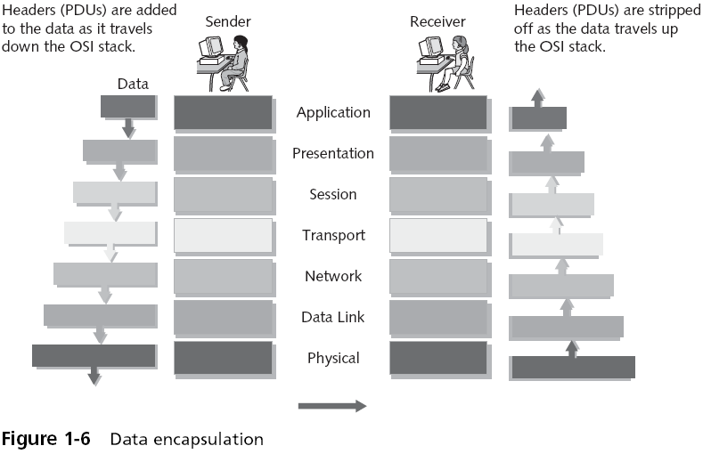
Layer Functions (continued)
Notes:
<number>

Slide 31
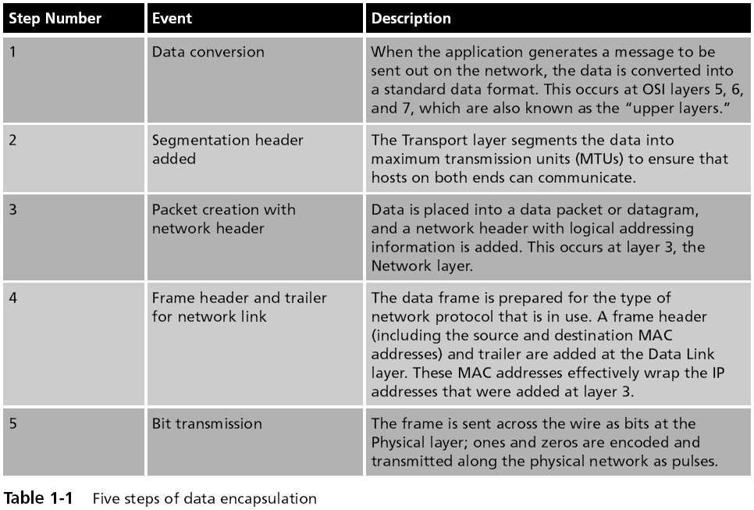
Layer Functions (continued)
Notes:
<number>

Slide 32
Summary
Two or more computers connected by media form a network
Before computers were networked, file transfers were usually conducted by users physically walking copies of data to another computer
The ISO developed the OSI model in the mid-1980s to standardize networking models
Data transmission can be connection-oriented or connectionless
The OSI networking model has seven layers
Notes:
<number>

Slide 33
Summary (continued)
The Physical layer handles the physical transmission of data across the network
The Data Link layer, the second layer of the OSI model, interacts with the networking hardware
The Network layer supports logical addressing and routing of data packets
The Transport layer segments data that is to be sent out on the network into MTUs
The Session layer, the fifth layer, establishes and maintains connections between computers during data transfers
<number>
Notes:
<number>

Slide 34
Summary (continued)
The Presentation layer, the sixth layer, handles data translation, encryption, and formatting for transmission on the network or for interpretation by the Application layer
The Application layer, the seventh and highest layer, handles the interface between the network and the user
When the network user sends data to the network, it goes through a five-step data encapsulation process
Notes:
<number>

Slide 35
Review

Slide 36
Chapter 1 Review
Which of the following objects can be used to connect a computer?
Radio
Ethernet Cable
Fiber Cable
ALL of the Above
Notes:
<number>

Slide 37
Chapter 1 Review
A webserver is what type of networking relationship?
Peer to Peer
Media
Client / Server
None of the above
Notes:
<number>

Slide 38
Chapter 1 Review
What is the name of the model that is widely used in Networking?
OSI
BSI
Peer to Peer
None of the Above
Notes:
<number>

Slide 39
Chapter 1 Review
Which is NOT part of an OSI model?
Application
Physical
Internet
Network
Notes:
<number>

Slide 40
Chapter 1 Review
Which layer in an OSI model where cabling is typically located?
Network
Physical
Transport
Application
Notes:
<number>

Slide 41
route7 Consulting Inc.
22960 Shaw Road, #600
Sterling VA 20166
703.544.2280
http://www.route7.net

